Slide 1
How to Create Inclusive and Accessible OER
Josie Gray
Advisor, Inclusive Design and OER Collections
BCcampus
josie.gray@bccampus.ca
Twitter: @josiea_g
March 5, 2020
Slides and additional resources: bit.ly/UBC-INCD
Notes:
Hello everyone,
Thank you all for taking the time out of your day to listen to me talk about accessibility in open educational resources. On my slides I’ve posted a link to where you can download these slides if you want to follow along on your own computer or refer back to them later. Those slides also include my speaking notes, so if those would be helpful you can access those there as well. The URL is bit.ly/(all caps)UBC-INCD
First, I would like to acknowledge with respect that we are gathered on the traditional, ancestral, and unceded territory of the Musqueam people, and I thank them for their hospitality. I’d also like to briefly bring attention to the conflict on Wet’suwet’en territory in northern BC and the solidarity actions that have been carried our across the country and around the world over the last few weeks. Yesterday students in colleges, universities, and high schools across the country walked out in support of Wet’suwet’en land defenders. On Lkwungen territory, Indigenous youth and supporters have occupied the ceremonial gates of the B.C. Legislature for over 10 days straight. And last night, 5 of those Indigenous youth were arrested in the middle of the night for peacefully occupying a meeting room inside the Legislature after their meeting with Minister of Indigenous Relations Scott Fraser ended. It felt important in my land acknowledgement to recognize and bring attention the very immediate and powerful ways that Indigenous people, and youth in particular, across the country are putting themselves at risk to assert the rights of Indigenous nations on their traditional and unceeded territory and to hold the Canadian and BC governments accountable to promises of reconciliation.
My name is Josie Gray and I work for BCcampus, a provincial organization in British Columbia that supports all of the post-secondary institutions in the province in the areas of teaching and learning, educational technology, open education, and other special projects. I am on the Open Education team, and I look after the B.C. Open Textbook Collection, provide support and training for people who are publishing open textbooks in Pressbooks, and I have also been working in the area of accessibility in open educational resources for over three years.
I am also working on my Masters of Design in Inclusive Design, where I will be focusing my research on the process of designing educational resources so that they are more adaptable to the diverse needs of individual learners and looking at the tools and processes that can support that design process.
Before I begin, I wanted to note that my slides are under a CC BY licence, which means you are free to use, modify, or share this presentation with attribution.

Slide 2
Open educational resources are…
“Freely accessible online.”
Notes:
In open education, there are a number of core values guiding the work we do. But one I want to highlight right now is “access.”
A statement that I quite often is that open educational resources are “freely accessible online.”
In my opinion, when people talk about OER as being “freely accessible online,” what they really mean is that the book is “freely available online.” Because when I see a statement like this beside a textbook, I check the book’s images for alt tags, I look for headings, and link text, and I am usually disappointed. Because although I’ve found a great textbook that is online with editable files and an open licence… it is not accessible for students with disabilities.
As I mentioned, part of my job at BCcampus is to manage the B.C. Open Textbook Collection. And as such, I’ve reviewed a lot of open textbooks from a lot of different publishers and authors. When I add a new book to the collection, there is a check that asks “Is this textbook accessible?” It is rare that I get to mark that checkbox as a yes.
And this isn’t surprising. Digital accessibility is not something most of us – if any of us – were taught in school. It may not be a default practice for you to be thinking about the accessibility of every digital document that you create. We get comfortable in our own ability, and its easy to forget that what may work for me, may not work for someone else.
If thought of at all, accessibility is still coming in as an afterthought in OER design. And this can cause a lot of problems. Not only can it cause problems in the design of the textbook, but it can make people less likely to ever take any steps to ensure a resources is accessible. When a resource is created without accessibility in mind, it often takes A LOT of work to come in after to make it accessible, and often once you get to the end of a long project, going back and spending a bunch of time fixing the accessibility might not feel worth it.
As someone who started her work in digital accessibility by remediating inaccessible open textbooks, I am absolutely sympathetic to this point of view. Remediation takes a lot of work, and it can be a frustrating process to have to go back and find a way to fix things.
But universal access to education is something that we say we value in the open education movement, and ultimately there is more to “access” than just putting a resource up for free online. For open, the “available for free online” does wonders for access when we understand access in a general sense, without looking too closely at the experience of individual students with a particular textbook. But in a movement that wants to make education open for everyone, including students with disabilities, we have to do better.

Slide 3
Agenda
Technical Accessibility
Web Content Accessibility Guidelines
WCAG in educational resources
Beyond Technical Accessibility
UDL: Multiple modalities, multiple formats
Inclusive design
Resources
Notes:
Here are the general topics that I want to cover today. We will start by looking at technical accessibility, which are the Web Content Accessibility Guidelines (or WCAG), and go over a number of accessibility requirements that are most relevant to the design of digital educational resources.
From there, I want to discuss a few things that go beyond technical accessibility, including universal design for learning (UDL) and inclusive design.
And finally, I will be providing a list of resources that can assist in this work.

Slide 4
Technical Accessibility
Web Content Accessibility Guidelines (WCAG)
Perceivable
Operable
Understandable
Robust
Notes:
So let’s start with technical accessibility. When talking about technical accessibility, I am referring to web content accessibility guidelines (WCAG). These are the minimum technical requirements that will allow students with disabilities to access all of the information in a digital resource. WCAG is an international digital accessibility standard that is developed and maintained by the W3C Web Accessibility Initiative.
WCAG has four main principles: That content and digital interfaces be perceivable, operable, understandable, and robust. I want to highlight the first three.

Slide 5
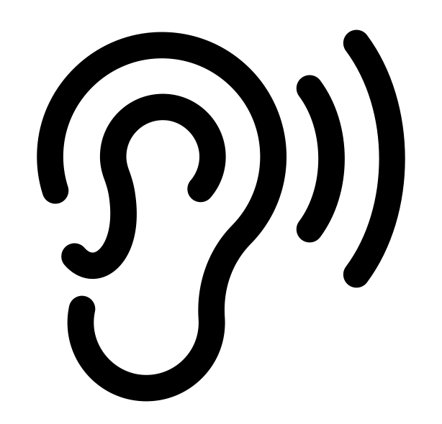


Principle 1: Perceivable
Information and user interface components must be presented to users in ways they can perceive.
Notes:
The first principle is perceivable, which is the idea that information and user interface components must be presented to users in ways they can perceive.
This principle focuses on the format and display of content. Basically, all content included in a resource should be perceivable through a user’s senses. That means all information needs to be available through sight, sound, and touch, or available in such a way that assistive technology could be used to translate that content for another sense.
So for example, a blind student may use a screen reader to access digital resources. This student will require text or audio alternatives of all visual content like images and video. In contrast, a deaf student will need captions or transcripts for video and audio-only content.
“Sight” by Alice Design (https://thenounproject.com/rose-alice-design). CC BY.
“Hear” by Dmitry Vasiliev (https://thenounproject.com/dimanebo). CC BY.
“Braille” by Hadi Davodpour (https://thenounproject.com/hadivoice). CC BY.

Slide 6
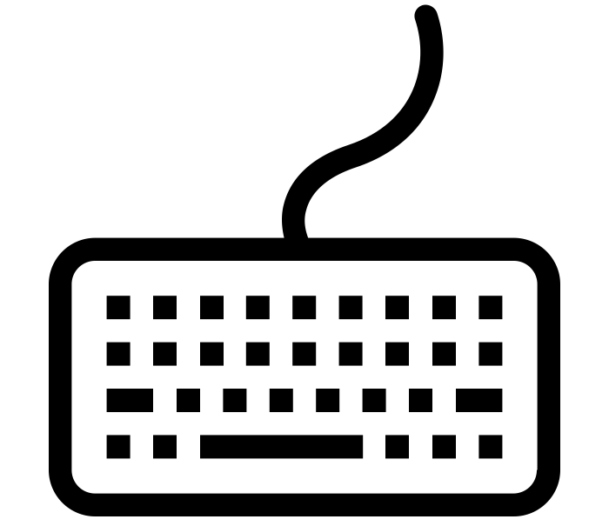
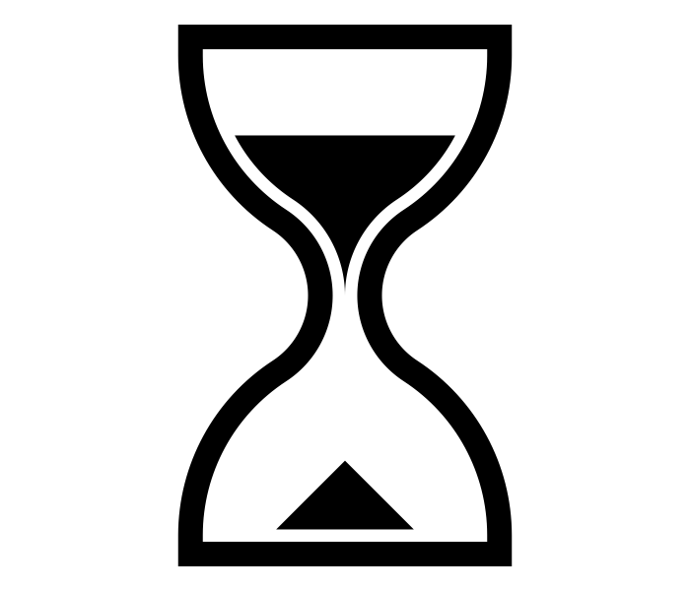
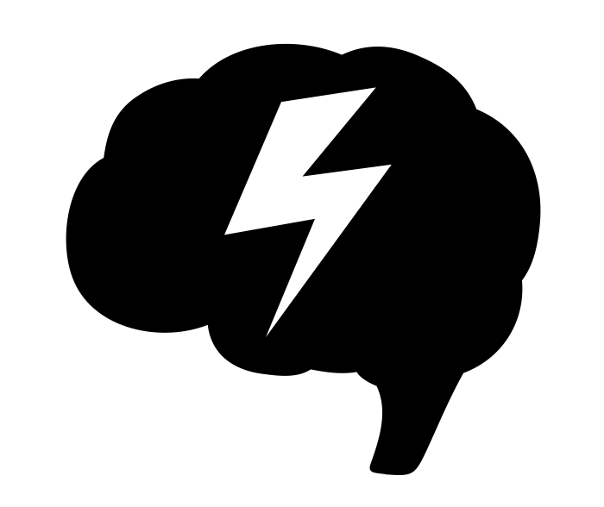

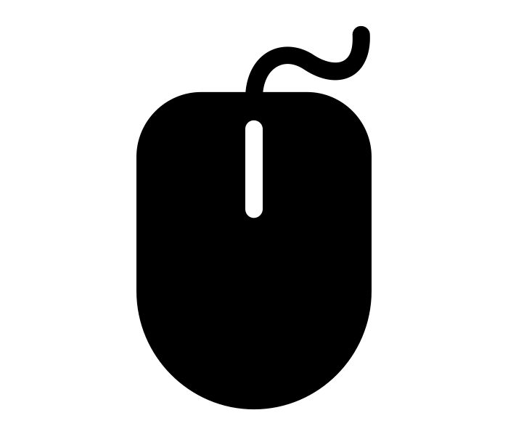
Principle 2: Operable
User interface components and navigation must be operable.
Notes:
The second principle is operable, which requires that user interface components and navigation must be operable.
The operable principle covers how people can navigate and interact with the resource. For example, someone should be able to navigate through a resource using only their keyboard, people should have enough time to complete tasks, none of the content should cause seizures or physical reactions, and navigation should be easy and make sense.
“Keyboard” by Vishal Patel from the Noun Project. CC BY.
“Mouse” by andriwidodo from the Noun Project. CC BY.
“Time” by Pham Duy Phuong Hung from the Noun Project. CC BY.
“Seizure” by Greg Pabst from the Noun Project. CC BY.
“Search” by Andreas Vögele from the Noun Project. CC BY

Slide 7


Principle 3: Understandable
Information and the operation of user interface must be understandable.
Notes:
The third principle is understandable, which holds that information and the operation of the user interface must be understandable. That means the text is readable and understandable, the layout of a page is predictable and consistent, and there are features that help users avoid and correct mistakes.
Now, I want to look at how these principles can be applied in the design of educational resources and look at more concrete examples.
“Book” by Sebastian Langer from the Noun Project. CC BY.
“Web Page” by Vectorstall from the Noun Project. CC BY

Slide 8
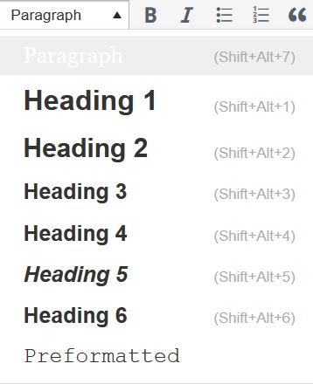
Organizing Content
<h1>Chapter 1: Introduction to Sociology</h1>
<h2>Introduction</h2>
Concerts, sporting matches and games, and political rallies can have…
<h2>1.1 What is Sociology</h2>
A dictionary defines sociology as the systematic study of…
<h3>What are Society and Culture?</h3>
Sociologists study all aspects and levels of society…
Content is organized under headings and subheadings
Headings and subheadings are used sequentially
Notes:
Let’s start with the organization of content, which is basically talking about the use of headings.
Using headings to identify sections and subsections of a document helps readers identify the structure and content of a document. Headings provide a visual cue that helps sighted readers quickly skim through content until they find a section they are looking for. Similarly, if there are headings, it makes it possible for someone using a screen reader to navigate a page or document.
A screen reader won't identify bolded or larger text as a heading. By marking up the sections and subsection of a chapter as headings, a screen-reader user can skip from heading to heading to get an idea about what the chapter is about, understand how the different sections relate to each other based on the heading levels, and skip to parts that they want to read. Without headings, a screen-reader user would be forced to read the entire chapter through from beginning to end every time they wanted to find specific information on a page.
As such, make sure content is organized under headings and subheadings and that headings and subheadings are used sequentially. So if your previous heading was a heading 2, your next heading shouldn’t be a heading 4 or 5.

Slide 9
Links
Not accessible
For more information on web accessibility, click here.
Not accessible
For more information on web accessibility, go to https://opentextbc.ca/accessibilitytoolkit/.
Accessible
For more information on web accessibility, refer to the Accessibility Toolkit.
Accessible
For more information on web accessibility, refer to the Accessibility Toolkit [New Tab].
Accessible
The BC Open Textbook Review Template [Word File] provides guidelines for completing an open textbook review.
The link text makes sense out of context
Links do not open in new windows or tabs (unless a text reference is provided)
The web address is available for those using a print copy
Notes:
Someone using a screen reader can also have all of the links on a page read out to them. For this reason, the text of a link should describe the content of the link, even when read out of context of the rest of the sentence.
I’ll go through a few examples of accessible and inaccessible links. > The first example has “click here” as the link text. Someone who can see the whole sentence can understand what the “click here” link is referring to. However, if someone using a screen reader had their device read out the links on this slide, all they would hear is the phrase “click here” and have no idea where that link would take them.
The second example shows the web address as the linked text. While it is better than the first example, it can still be confusing when a screen reader reads out a web address, especially if it is long and complicated.
The third example is the most accessible as the link text is “Accessibility Toolkit,” which still makes sense when out of the context of the rest of the sentence. My recommendation would be to use the title of the webpage as the link text wherever possible.
Finally, links should not open into new windows or tabs as it can be disorienting and confusing if the user – sighted or non-sighted – is not expecting it. However, if it is important that a link open in a new tab or window, include that information in the link text. This also applies with linking to different document types, such as PDFs, Word files, or Excel files. Because these formats may have different accessibility barriers, require time and bandwidth to download, and require appropriate software to open, it is best practice to include the file type in the link text as shown in the last example.
Now if the resources you are creating will also be available in print format, you will want to provide a way for print users to access the web addresses. You might do this by putting the web address in a footnote or by creating a page containing a list of links at the end of the resource.

Slide 10
Data Tables
Table 15.1 One way scholars have categorized religions is by classifying what or who they hold to be divine
Religious Classification | What/Who Is Devine | Example
Polytheism | Multiple gods | Hinduism, Ancient Greeks and Romans
Monotheism | Single god | Judaism, Islam, Christianity
Atheism | No deities | Atheism, Buddhism, Taoism
Animism | Nonhuman beings (animals, plants, natural workd) | Indigenous nature worship, Shinto
Tables include a caption.
Tables include row and/or column headers.
Row and column headers have the correct scope assigned.
Tables do not have merged or split cells.
Tables have adequate cell padding.
“Religious Classification table” © William Little. CC BY.
Notes:
For tables to be accessible, they have to be marked up correctly. This means they need a
Caption that describes the purpose of the table
Heading cells must be marked as headings with the correct scope assigned (meaning they are marked whether they are a column header or a row header)
No merged or split cells
There is adequate cell padding
In this example, the table has a caption. The table also has a header row with three cells. These header cells are marked as headers and have their scope set to “column,” because they are column headers.
Using header cells ensures that the table will be read out correctly by screen reader technologies. The screen reader will read out the cells from left to right, row by row, and when you use column headers, the screen reader will announce what column each data cell falls under as it goes.
If a table is a really long table, it is also recommended to provide a way for people to “Skip” the table, which will save people from having to navigate through the entire table if they aren’t interested in the content.
I won’t go into any more detail here. But if you are inserting tables into the resources you create, you can find specific instructions on how to ensure that the tables are accessible in the Accessibility Toolkit’s chapter on Tables, which I will be providing a link to at the end of this presentation.

Slide 11
Audio
Examples: Podcasts, interviews, recorded lectures
A transcript provides a text equivalent of audio content. It includes
Speaker name(s)
Headings and subheadings
All relevant audio content, including
All speech content
Relevant descriptions of speech
Descriptions of relevant non-speech audio
Include a transcript
Notes:
If your resource includes audio, such as a podcast, an interview, recorded lecture, or a song, there should also be a transcript of that audio. The transcript should include the speakers names, headings and subheadings for navigation if it is long, and all relevant audio content, including all speech content, relevant descriptions of speech, and descriptions of relevant non-speech audio.

Slide 12
Video
Captions: Text that is synchronized with audio in a video.
Audio descriptions: Audio descriptions of visual content shown in the video that isn’t conveyed through audio
Transcript: Includes the same information as with audio transcripts, but may also include relevant description of visual content
All relevant visual information is conveyed via an audio description or transcript
All relevant audio information is conveyed via captions or a transcript
Notes:
If your resource includes video, all relevant visual information needs to be conveyed in an audio description or transcript and all relevant audio information needs to be conveyed via captions or a transcript.
Captions are text that is synchronized with the audio in a video.
Audio descriptions are for someone who can’t see the video and need descriptions of visual content shown in the video that isn’t conveyed through the audio.
A transcript includes the same information as with audio transcripts but may also include relevant descriptions of visual content.
If you are creating video, try to plan and design the video so that people who can’t see the video still know what is going on without needing an alternative format. You can do this by having the people in your video or a narrator describe any important visual information while recording so an alternative format is not required.

Slide 13
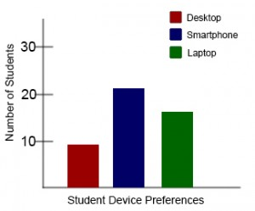
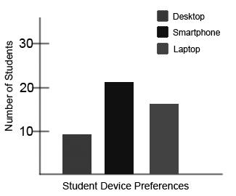
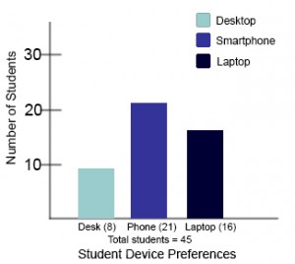
Colour and Colour Contrast
Information is not conveyed by colour alone
There is sufficient colour contrast between foreground and background
“Student Device Preferences Graphs” by BCcampus. © CC BY
Notes:
Paying attention to the use of colour and colour contrast in web content is important for people who have low or poor-contrast vision, are colour blind, or for those who use a device with a monochrome display or who may be printing in black and white. In addition, information should never be conveyed by colour alone.
Here is a bar graph that is charting student device preferences. It uses the colours red, blue, and green to differentiate between students who prefer desktops, smartphones, or laptops.
When the same graph is seen in greyscale, it becomes really difficult to tell which bar corresponds with which category. The red and the green look almost identical. This may be a serious barrier for someone who has a hard time differentiating between colours or someone who has printed their resource in back and white.
This problem can be solved by using colours with higher contrast ratios, and by adding labels to each bar, as shown in the bottom example. Adding labels to each bar ensures that the meaning of this graph is not only being conveyed by colour.

Slide 14
Contrast Checker
https://contrastchecker.com/
Notes:
If you’re looking for a tool to help measure colour contrast, I would recommend contrastchecker.com, which allows you to test the contrast between colours and will give you pass or fail ratings based on WCAG standards.

Slide 15
Images
A decorative image does not need a text description.
Is primarily for design
Does not convey content (or are already described in surrounding text)
Images that convey information include alternative text (alt text) descriptions of the image’s content or function.
Images that are purely decorative do not have alt text
Graphs, charts, and maps include contextual or supporting details in the text surrounding the image.
Images do not rely on colour to convey information.
A functional image contains content that requires a text description.
Alt text
Surrounding text or caption
Long description
Notes:
The next number of slides with be focusing on images and different strategies for describing images.
When talking about images, we need to make distinction between decorative images and functional images. Decorative images are images that are used primarily for design and do not convey content. Or they convey content that is already described in the surrounding text. As such, they do not need text descriptions.
Functional images are images that convey important non-text content. For functional images, you have to consider what information would be lost if those images weren’t available. This information needs to be provided in a text format.
There are three ways to provide text descriptions for images:
Describe the image in the alt text field. This is sometimes referred to as the alt tag or the alt attribute.
Describe the image in the surrounding text or a caption.
Create and link to a long description of the image.

Slide 16
Text Descriptions
What to describe
Content/purpose of the image
Main focus of the image
May depend on audience/context
How to describe
Clear, concise, and accurate
Go from general to specific
Use words rather than symbols when writing math or scientific expressions
Who? What? Where? When? Why?
Adapted from © Supada Amornchat. Complex Images for All Learners [PDF]. CC BY-NC-SA.
Notes:
When thinking how to describe images, here are something to keep in mind.
In terms of what to describe, focus on the content and purpose of the image? What is the image trying to convey? Note that this will likely depend on the audience and context.
In terms of how to describe, make sure you are clear, concise, and accurate. Go from general to specific. Use words rather than symbols when writing math or scientific expressions. Think about who? What? Where? When? Why?

Slide 17
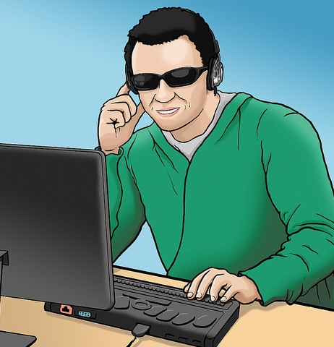
Alt Text
A short text description of an image that appears in the alt attribute of the image tag.
Will not appear visually
Can be accessed by text-to-speech technology (including screen readers)
Should be less than 125 characters
Does not need to include “Image of..”
“WFE003: Jacob” © Rosenfeld Media. CC BY
Notes:
Now let’s talk about the different place you can describe an image. The most common is the alt text.
Alt text is a short text alternative for an image that those using screen readers can access. The alt text will also be displayed if images aren’t loading due to a weak internet connection. Depending on the tool you are using to create your OER, you will be able to add the alt tag when you upload the image or when you edit the image.
When creating a alt text there are some things to keep in mind:
The text will not appear visually in your resource, but it can be accessed by text-to-speech technology
Second, there is no need to include “image of” in the alt text, a screen reader will announce the presence of an image before reading the content of the alt text
And finally, alt text is meant to be short. Keep alt tags under 125 characters, including spaces and punctuation. If an image requires a longer description, describe it in the surrounding text or add a long description.
If an image is decorative or described in the surrounding text, you can leave the alt text blank. This will ensure that a screen reader will skip the image.

Slide 18
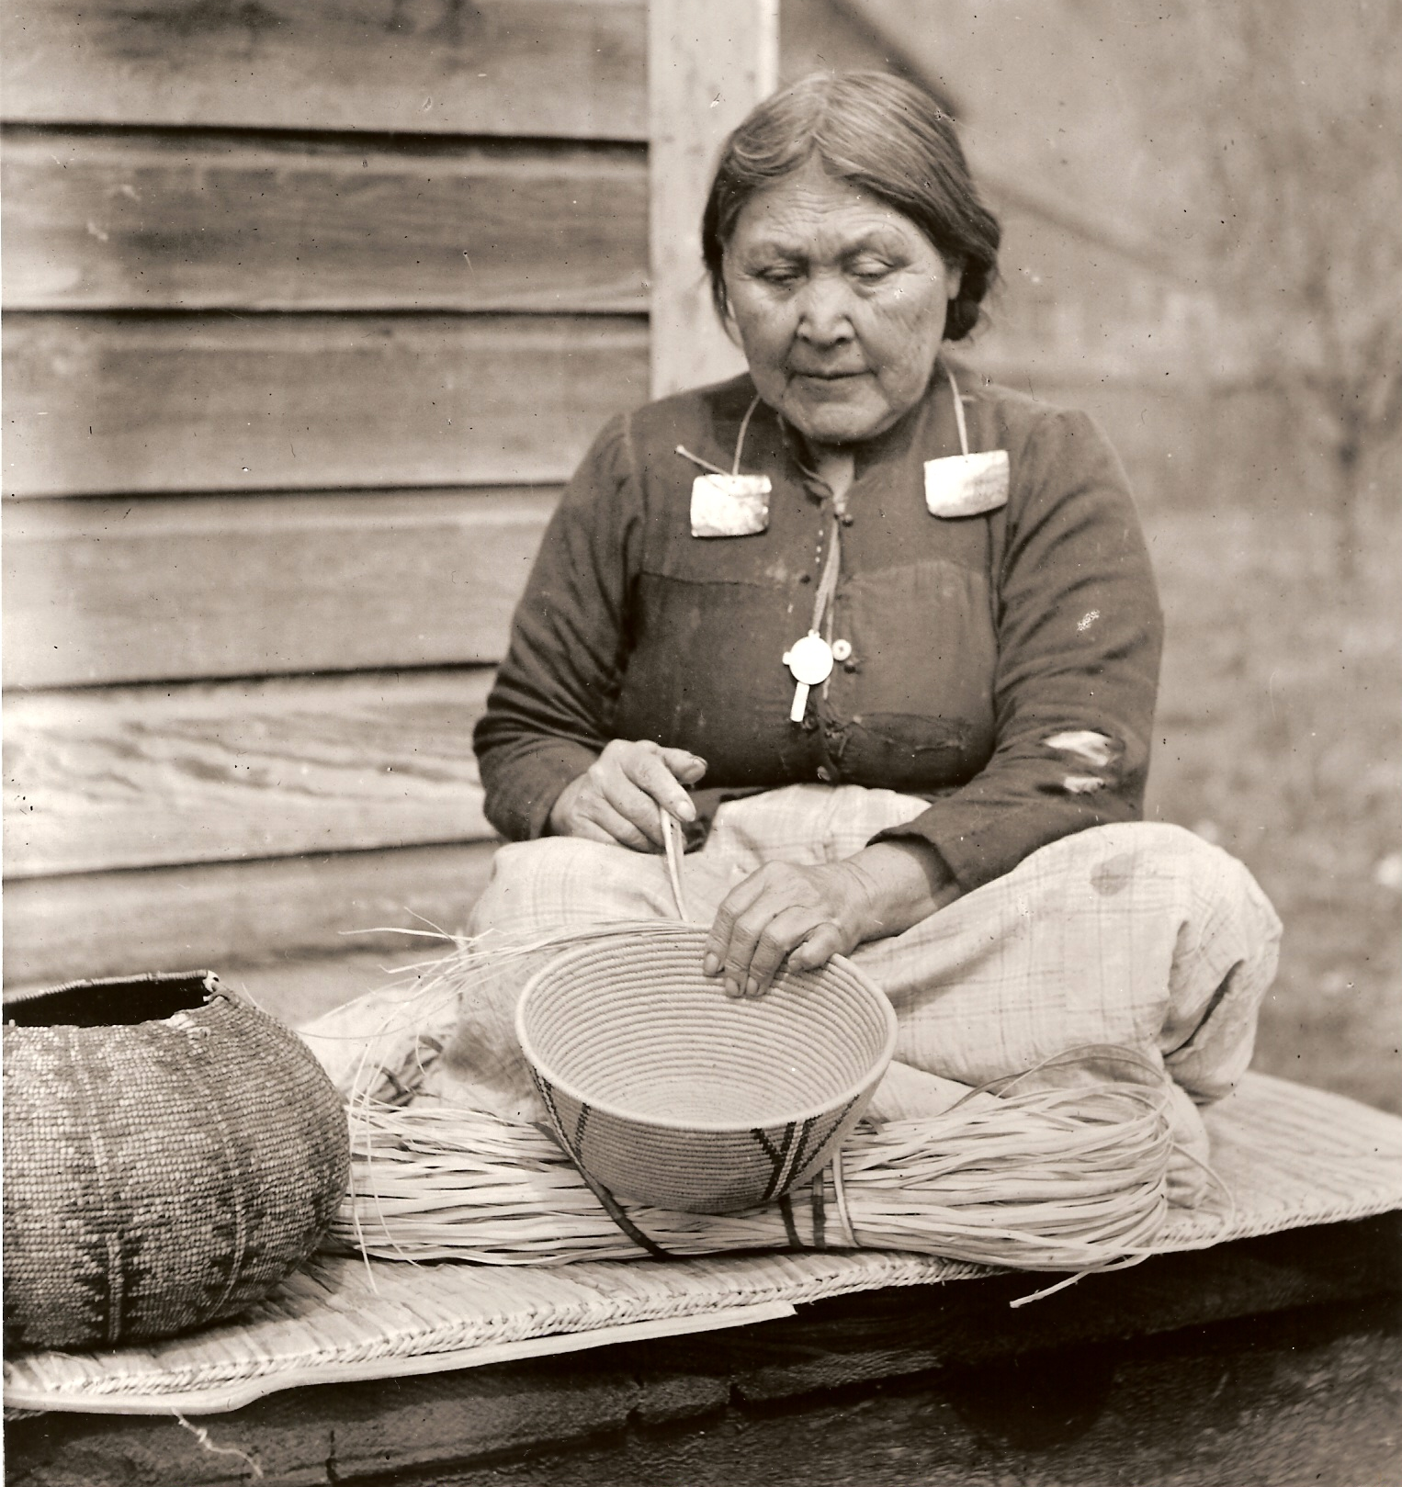
Surrounding Text or Caption
Figure 2.3 In 1871, the newcomer population in B.C. was still outnumbered by Aboriginal people who were, nevertheless, being hustled onto reserves and mostly without treaties. A Stó:lō woman, weaving baskets, n.d.
Stó:lō woman with a cedar basket by Royal British Columbia Museum (PN996). Public Domain. Image caption © John Belshaw. CC BY.
Notes:
You can also use the surrounding text to provide the same information as provided in the image. This is often the best option for complex images because it makes the information available for everyone, not just those using the alt tags. If an image has been adequately described in the caption or surrounding text, you can either provide a few-word description of the image as the alt text or not provide alt text.
In the image shown here, the caption reads, “A Stó:lō woman weaving baskets,” which adequately describes the image. Therefore, alt text is not required.

Slide 19
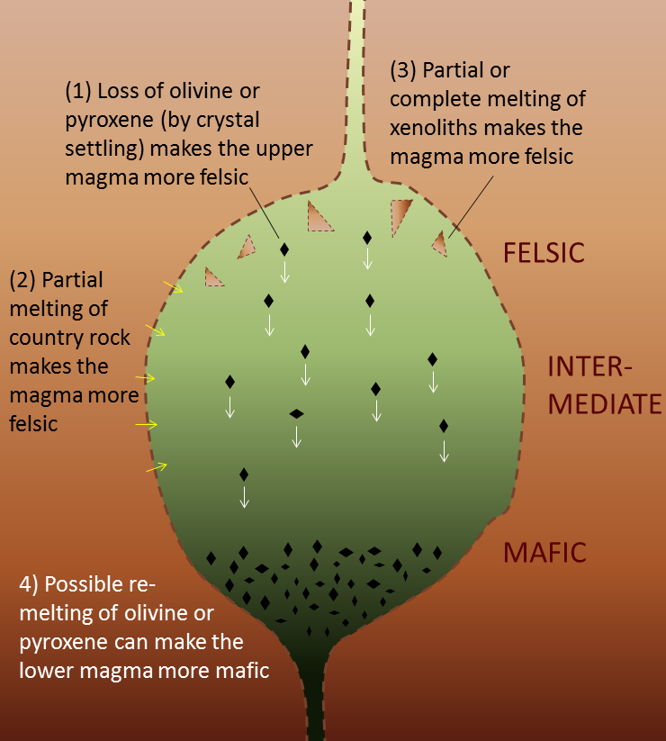
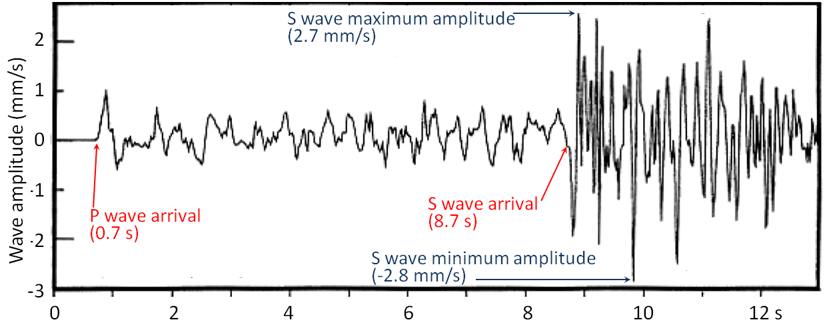
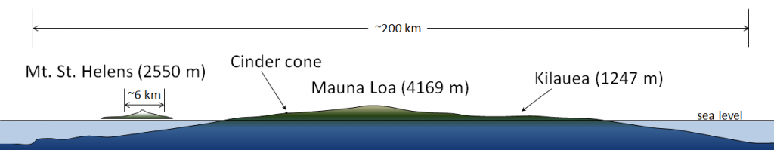
Long Descriptions for Complex Images
Examples
pie charts, bar carts, line graphs, flow charts, diagrams, illustrations, math graphs, and maps
Magma Chambers, P and S Waves, and Volcano Size © Steven Earle. CC BY
Notes:
Complex images such as charts, graphs, diagrams, maps, and more will likely require longer descriptions than can fit in an alt tag. In these cases, you will need to create a long description for the image that students who can’t see the image can accesses.
For some images, you may be able to describe them in a few sentences or a paragraph. But over the next few slides I want to highlight different strategies for describing different types of complex images that might be more effective and manageable.

Slide 20
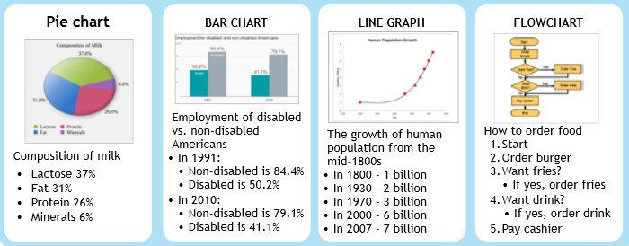
Lists
Bulleted and numbered lists can be used to present information found in
Pie charts
Bar charts
Line graphs
Flow charts
Adapted from © Supada Amornchat. Complex Images for All Learners [PDF]. CC BY-NC-SA.
Notes:
The first is lists. You can use bulleted and numbered lists to represent information that is presented in pie charts, bar charts, line graphs, and flow charts.

Slide 21
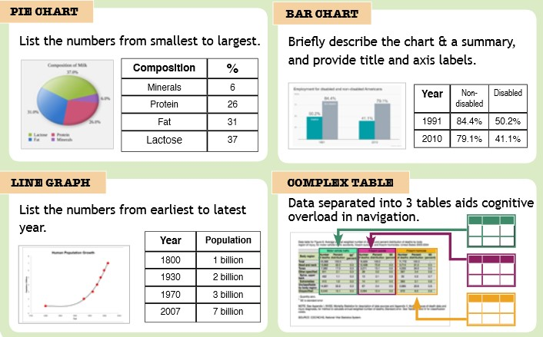
Data Tables
Data tables can be used to present information found in
Complex tables
Bar charts
Line graphs
Pie charts
Adapted from © Supada Amornchat. Complex Images for All Learners [PDF]. CC BY-NC-SA.
Notes:
You can also use data tables to represent information found in complex tables, pie charts, bar charts, and line graphs.

Slide 22
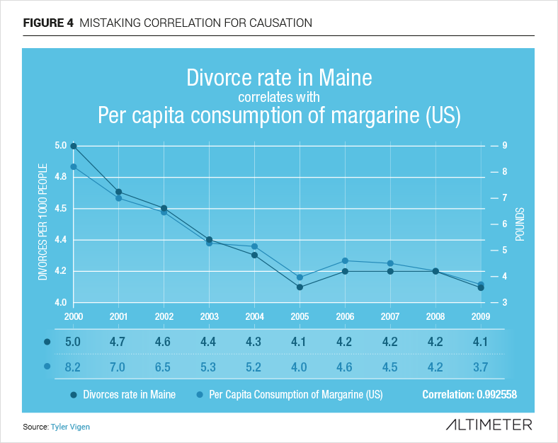
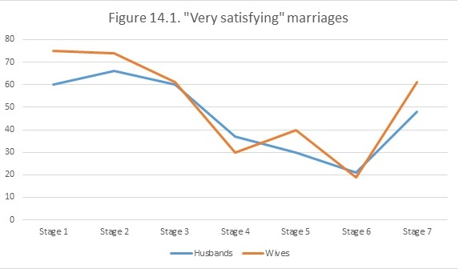
How would you describe these images?
“Mistaking Correlation for Causation” by Altimeter. © CC BY-NC-SA
“Figure 14.1” © William Little. Based on data from Lupri and Frideres, 1981. CC BY.
Notes:
Here are two images that look quite similar. They are both line graphs that appear in an Introduction to Sociology textbook.
I put them us here to illustrated how the context and significance of an image needs to be considered when deciding how to describe an image.
The image on the left shows a line graph that shows close correlation between the divorce rate in Maine and the United States' per capita consumption of margarine. This image was included in the textbook to illustrate that correlation does not equal causation. In this example, the visual trend shown in the graph is more important than the individual data points. The rate at which they fell from 2000 to 2005 does not matter as much as the fact that the graph shows them falling and rising again at almost exactly the same rate. Instead of replacing this image with a data table, a short description describing the point of the image is more useful.
The image on the right shows the number of husbands and wives in different stages of family life who described their marriage as “highly satisfying.” In this case, while the visual graph is useful for sighted users, it would be quite difficult to describe in a sentence or paragraph, and the student might be expected to compare and contrast the data points. The best solution here is to provide an accessible table based on this graph.
Does anyone else see any other accessibility problems with the graph on the right?

Slide 23
Symbols
x or × or ·
- or − or —
÷ or /
½ or 1/2
Notes:
Now I want to talk a little bit about math accessibility. This is an area that I am still learning about and have limited experience in, but it is a topic that I get questions about a lot and one that I am working hard to learn more about.
The most common mistake I see with regards to math accessibility is authors using incorrect symbols for simple math equations. This is generally the case in books that aren’t math books but use these symbols for basic equations or to convey things like negative degree temperatures.
I have put a number of symbols up on the slide. The first row uses different symbols that might be used to denote multiplication. However, a screen reader would only read the middle symbol as “times.” The first symbol is would read as an x and the last it would read as a dot.
In the next line, the first and last symbols are a hyphen and an em-dash, and as such, screen readers don’t announce their presence unless settings are changed. Only the middle symbol is something a computer would read as a “minus” sign.
The next line shows a division sign and a forward slash.
And the last example shows a fraction. A computer would read the first fraction as “one-half” or “one over 2.” It would read the second fraction as ”1, 2.”
Another thing to keep in mind is the different ways we use math symbols. For example, in chemistry, you might want to say that an element has a charge of negative one or positive 2. But when talking about addition and subtraction, you would want those same signs to be read as minus and plus.

Slide 24
Formulas: MathJax
MathJax
This a display engine that translates mathematical markup (like MathML or LaTeX) into accessible, high-resolution equations.
This allows the equations to be rendered aurally or visually.
Formulas have been created using MathML.
Notes:
When dealing with more complex math equations and formulas, using symbols is not longer enough. There are two ways to make math accessible. The first and best option is to create equations using MathML or LaTeX, which are both mathematical markup languages, and then use MathJax to render those equations. MathJax will translate the markup into accessible, high-resolution equations. As long as the markup prioritizes the meaning of equations over the display, then screen readers will be able to accurately interpret the equations.

Slide 25
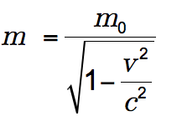
Formulas: Images with Alt Text
Formulas are images with alternative text descriptions if MathML is not an option.
Alternative Text:
m equals begin fraction m sub 0 over begin square root 1 minus begin fraction v sup 2 over c sup 2 end fraction end square root end fraction
Notes:
If MathML or LaTeX isn’t an option, the next best option is to provide an image of the equation and provide an alternative text description. I’ve provided an example on this slide. It reads, m equals begin fraction m sub 0 over begin square root 1 minus begin fraction v sup 2 over c sup 2 end fraction end square root end fraction.
In 2014, BCcampus conducted a user-testing session with visually impaired and blind students who indicated that it would be helpful to place an audio file of the formula or equation alongside the equation, allowing the student to hear exactly how the formula or equation should be interpreted.

Slide 26
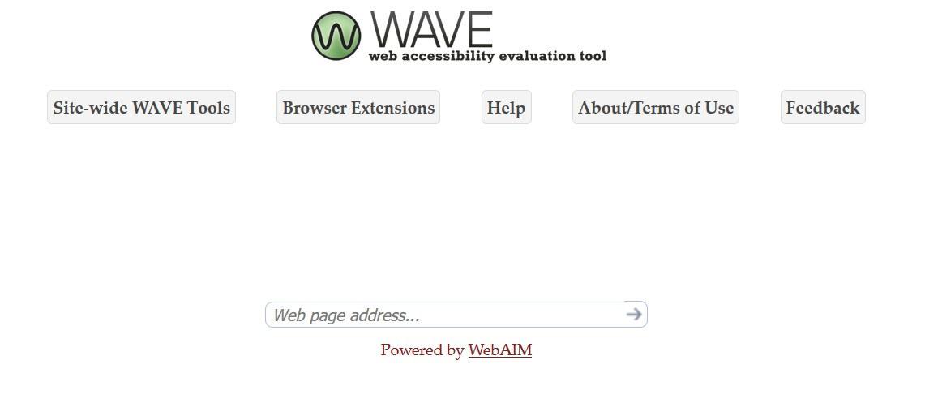
WAVE (Web Accessibility Evaluation Tool)
https://wave.webaim.org/
Notes:
If you are publishing web-based resources, I would highlighly recommend WAVE, an accessibility checker. It is super easy to use and will highlight most accessibility problems. You can either paste a link to the page you want evaluated or install it as a browser plug in.
I should also note that a lot of software includes built-in accessibility checkers, including Microsoft Word and PowerPoint. However, keep in mind that using an accessibility checker doesn’t prove a resource is accessible, but they can be helpful in identifying accessibility issues that you might have missed.

Slide 27
Beyond Technical Accessibility
Limitations of accessibility checklists
Universal Design for Learning (UDL)
Inclusive design
Adopting accessible practices
Notes:
Now I want to transition beyond technical accessibility. Up to this point, I have mostly provided a checklist approach to accessibility by giving you a collection of success criteria, so I want to complicate that a little but by talking about
Limitations of Accessibility Checklists
Universal Design for Learning
Inclusive Design
And how we can go about adopting accessible practices

Slide 28
Accessibility Checklists
Strengths
Easy to understand and follow
Highlight the most important technical considerations to make sure students with disabilities can access the material
Weaknesses
Accessibility as something that we can go back and fix later
Do not ensure good design
Do not account for the multiple formats of OER
Students face challenges not addressed in standard accessibility checklists
Does not ensure equal access to learning outcomes
Notes:
A lot of the accessibility considerations I have talked about so far are things that can be checked off. Do you images have alt text? Check. Does your table have a caption? Check. Do your videos have captions?
I’ve started by focusing on these checklist items because there are concrete and easily actionable. In addition, these items make up the very important minimum technical considerations to make sure students with disabilities can access their educational materials.
However, a checklist approach to accessibility has a number of weaknesses. It makes accessibility seem like something that can be fixed later, it does not ensure good design, it does not account for the multiple formats of OER, students face access challenges that are not addressed in standard accessibility checklists, and it does not ensure equal access to learning outcomes.

Slide 29
What is an average student?
The classroom, “far from neutral, is constructed for a mythical, “able-bodied,” neurotypical norm that neither reflects nor accommodates the wide range of diverse learners within it, regardless of whether these learners have been diagnosed with a disability” (Wilson, 2017).
Notes:
Students may face all sort of barriers even if they don’t have a diagnosed disability, and there is not really such thing as an “average student.”
In an article by Jan Wilson, she argues that the classroom,
“far from neutral, is constructed for a mythical, “able-bodied,” neurotypical norm that neither reflects nor accommodates the wide range of diverse learners within it, regardless of whether these learners have been diagnosed with a disability.”
What she is getting at here is this problem that comes up when we design for what we think is normal, or what we think is average. The reality is, there is no such thing as a normal or average student. Students vary greatly in their interests, family situation, culture, background, experience, strengths, and weaknesses. And all students benefit when educational materials are designed to be accessible and inclusive.

Slide 30
Medical vs. Social Model of Disability
Notes:
When talking about accessibility and inclusive design, it is helpful to talk a bit about how we think about disability.
The medical model of disability “understands disability as an individual problem, affliction, or deficit that needs a cure or accommodation.” It sees disability as grounded in the individual. This is the model that is used in medical settings, and it is also used at universities and colleges where students need to have a diagnosed disability to be eligible for accommodation.
In contrast, the social model of disability sees disability emerging when there is a mismatch between a person and their environment.
The social model of disability illustrates the false dichotomy between bodies and minds we perceive as “disabled” and those we perceive as “abled.” Instead, disability becomes more of a spectrum that can affect different people in different ways depending on their context, environment, and the tools they have access to, and is a product of history and culture.
The social model of disability is useful for challenging how we perceive and understand disability. It gives us a way to do something about disability and a motivation to help break down barriers for those with disabilities through inclusive design.

Slide 31
What else affects accessibility?
Day-to-day life
Digital literacy
Access to technology
Structure of information
Presentation of information
Notes:
All sorts of things affect the accessibility of a resource, and these things are very much context dependent and can vary from student to student.
For example, a student’s day-to-day life can affect access. Consider a student who spends an hour on a crowded bus everyday commuting to school and spends long days on campus studying. For this student, a heavy print textbook would be really annoying, and they might decide to leave it at home rather than lug it to school. That is a barrier to access.
Another example is differences in digital literacy among students. Many OER are primarily online resources, and for those of us who work on a computer all day take for granted our comfort and experience with working with digital content. Even young college students who grew up with smart phones and easy access to Internet may not know how to search a PDF or understand how to take advantage of the different features in Pressbooks or know that an EPUB file can be accessed on their phone. If your students are adult learners, paying attention to digital literacy and comfort using digital materials will be even more important. A student can’t learn well from a resource they don’t know how to use or don’t like using.
Another example is access to technology. Not every student has access to a computer. For example, I know a trades student who only spends a few months of the year in school. They don’t have a computer because they usually don’t need one. If they want to watch Netflix, they borrow their roommate’s laptop. But last year, this person had a course where the textbook was only available online. Without a personal computer, this student regularly struggled with accessing their textbook.
Day-to-day life, digital literacy, access to technology – all of these things are very individualized and context dependent. And these are things were OER in particular has the potential to really make a difference. Everyone has a preference in how they would like to access their learning materials, and open educational resources that are available in multiple formats make it possible for students to pick the format that they are most comfortable with and will work best for them.
For example, the trades student I mentioned would really have valued a copy they could read on they phone or a print version. Someone who spends long hours on transit would likely prefer a digital copy that they could download on their computer for easy offline access. Someone who likes to annotate their textbooks would probably love PDFs. By providing students choice, there is the potential to really improve the learning experience.
But with multiple formats come new challenges. Accessibility looks different in a print textbook than it does in a webbook, eBook, or PDF, and if you are providing all of these formats, you have to ensure that students using each format can access the same information. For example, people using a print version will need web addresses if they are going to be able to access any external resources linked to in your book. And a lot of students still really want a print copy. So that’s something to keep in mind when you’re considering how much interactive content you want to include in your resource that cannot be printed.
The final thing I wanted to highlight is the structure of information. How can you organize and structure your textbook or resource to make it easy to use and easy to find information and navigate. That means paying attention to the number of chapters, the titles, the use of sections and subsections, numbering systems, headings, and more. These considerations will vary from book to book, but the more intentional you are about thinking about structure, organization, and navigation, the more useful and powerful your resource will be, which on its own will increase access.

Slide 32
Universal Design for Learning (UDL)
Provide multiple means of
Engagement
Representation
Action and Expression
What might multiple means of representation look like in OER?
Incorporating multiple modalities (video, audio, interactive activities)
Making resources available in multiple formats (PDF, HTML, EPUB)
http://udlguidelines.cast.org/
Notes:
Part of what I am talking about here is Universal design for learning, or UDL. UDL encourages designing teaching and learning environments and materials so that they provide multiple means of engagement, representation, and action and expression for students. This is a huge topic and much more than I could every cover in one slide, but I did want to highlight the principle of multiple means of representation and what this might look like in open educational resources.
This could include incorporating multiple modalities, including video, audio, and interactive activities
It might also look like making resources available in multiple formats, such as PDF, HTML, or EPUB

Slide 33
Inclusive Design
“Design that considers the full range of human diversity with respect to ability, language, culture, gender, age, and other forms of human difference.”
— Inclusive Design Research Centre
Notes:
When we bring all of these things together, all of these considerations, all of these practices, we are really starting to talk about inclusive design.
Inclusive Design is defined by the Inclusive Design Research Centre as “design that considers the full range of human diversity with respect to ability, language, culture, gender, age and other forms of human difference.” In inclusive design, one of the most important things is recognizing the people are different. And by designing for differences, we can create things that are more useful, powerful, and accessible to all.
With inclusive design, the work is never done. It’s not a box you can check off. It is an iterative and ongoing practice.

Slide 34
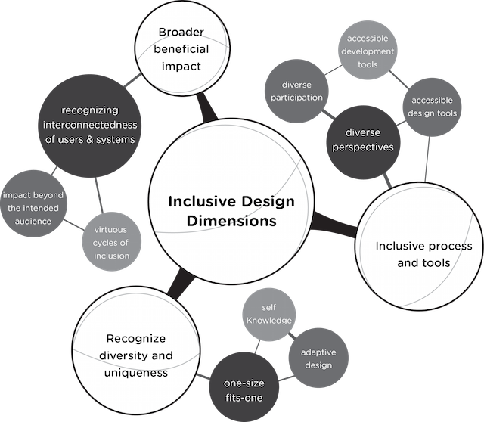
Inclusive Design Dimensions
“Inclusive Design Dimensions” by the Inclusive Design Research Centre. CC BY.
Notes:
The IDRC has identified three dimensions that make up inclusive design:
One is, recognize diversity and uniqueness. This includes looking at design as a one-size-fits-one, rather than a one-size-fits-all, a use of adaptive design, and respecting self-knowledge. This dimension encourages design that is flexible and empowers people to use the resource in the way that works best for them.
The second dimension is inclusive processes and tools. This really looks like the process of design and who is included. When designing for inclusion, we have to consider and include diverse perspectives and participation.
The third dimension is broader beneficial impact. This dimension encourages us to recognize the interconnectedness of users and systems. When we design for inclusion, our impact often goes much beyond the specific audience we are designing for and can encourage virtuous cycles of inclusion that build on each other.

Slide 35
Adopting Accessible Practices
How can you build accessibility considerations into the creation process?
What are the different formats that you can make available?
How can you empower the students using the resource to take advantage of the features and options available?
How can you collect and encourage student feedback and leverage the diverse needs of students to design better?
Notes:
I get that it can be a lot of work, and thinking about accessibility adds another layer to the already complex process of developing and adapting open educational resources. However, as a community that values *access,* it’s something we need to be always thinking about, and always striving to improve.
For those involved in creating and publishing open textbooks and other OER, think about how you can include accessibility considerations as part of the creation process. Talk to authors about it early. Include accessibility in style sheets; design, format, and organize with accessibility in mind from the very beginning. Think about the different ways that students may want to access information and what formats you can make available. For example, think about how you will make sure that students using a print copy and students using a digital copy can access the same information
When it comes time to share the resource with students, make sure they know how to use it.
• Are they aware of all formats available and how to use those formats?
• Are there features that allow them to customize their experience?
• Are their tools that allow them to interact with the content in a different way? Think annotation tools or text-to-speech software
And then be open to and encourage feedback from your students. Ask them what they liked and didn’t like about the resource.
Did they find any sections confusing?
Where they able to find information?
Did it work on their devices?
Ultimately, accessibility and inclusion isn’t a one-and-done kind of a thing. It is not a pass/fail. It is a spectrum, and it may look differently for each person depending on their context. And that plays into one of the best parts of OER: the ability for us to be able to go in and keep making things better.

Slide 36
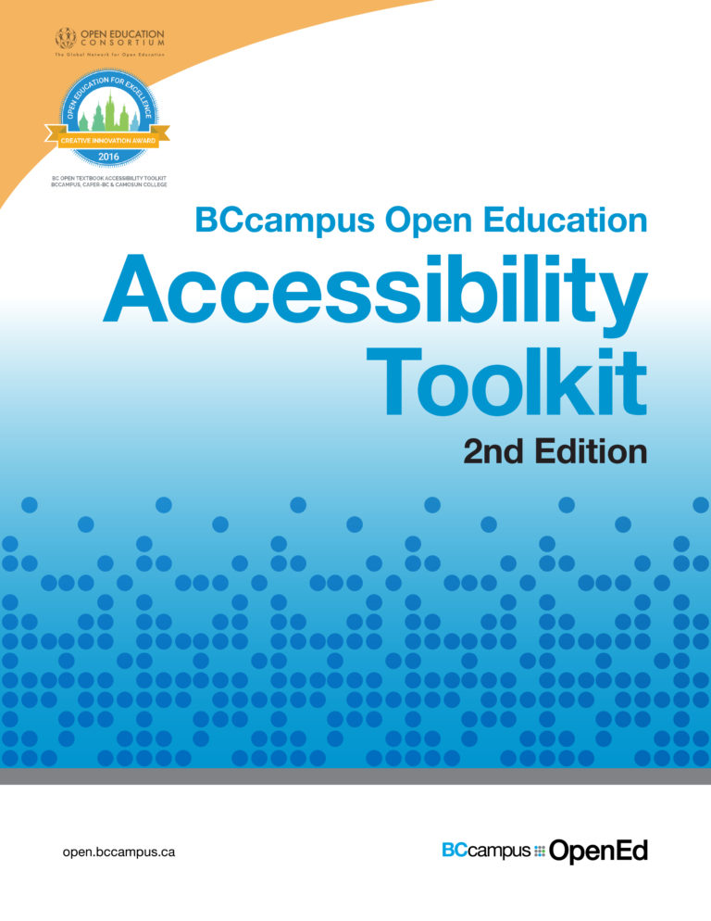
Accessibility Toolkit
https://opentextbc.ca/accessibilitytoolkit
Information about how to create accessible educational resources
Accessibility checklists
Activities
Webinars on Inclusive Design
Accessibility Toolkit cover © BCcampus. CC BY
Notes:
Before we finish, I wanted to point you all to the Accessibility Toolkit, published by BCcampus. This toolkit covers a lot of the same information that I covered today and often in more detail. It also provides an accessibility checklist, activities, and links to a series of webinars on inclusive design.
The toolkit can be accessed at opentextbc.ca/accessibilitytoolkit

Slide 37
Questions?
Download the slides and list of resources from the following link: bit.ly/UBC-INCD
Notes:
Here again is the link to where you can download my slides from today. I’ve also posted a PDF with a big list of tools and resources I mentioned in my presentation plus additional ones I’ve found really helpful.
Questions?

Slide 38
References
Amornchat, S. (n.d.). Complex images for all learners: A guide to making visual content accessible [PDF]. Retrieved from https://www.lsu.edu/accessibility/training/complex-images.pdf
CAST. (2018). Universal Design for Learning Guidelines version 2.2. Retrieved from http://udlguidelines.cast.org
Coolidge, A., Doner, S., Robertson, T., Gray, J. (2018). Accessibility Toolkit – 2nd Edition. Victoria, B.C.: BCcampus. https://opentextbc.ca/accessibilitytoolkit/
Inclusive Design Research Centre. (n.d.). What is inclusive design? Retrieved from https://idrc.ocadu.ca/about- the-idrc
Kirkpatrick, A., O Connor, J., Campbell, A., & Cooper, M. (Eds.) (June 5, 2018). Web Content Accessibility Guidelines (WCAG) 2.1. WC3. https://www.w3.org/TR/WCAG21/
Wilson, J. D. (2017). Reimagining disability and inclusive education through universal design for learning. Disability Studies Quarterly, 37(2). http://dx.doi.org/10.18061/dsq.v37i2.5417

